Slide 1


Fast threshold tests for detecting discrimination
February 21, 2019
E. Pierson, S. Corbett-Davies, S. Goel, 2018 AISTATS Conference
Review presented by
Mai Lee Chang, Marius Arvinte
The University of Texas at Austin

Slide 2
Motivation
Wide interest in detecting and quantifying bias in human decision
Do decision makers apply different standards to groups defined by race, gender, or other protected attributes (taste-based discrimination)?
Discrimination examples:
Banking: Minorities are granted loans only when they are exceptionally creditworthy.
Policing: Black pedestrians are stopped more for weapons search.
Challenge:
Individual’s characteristics are typically only partially observable.
Unclear whether observed disparities or omitted variables are attributable to discrimination.
This work aims to reduce the computational complexity of discrimination detection tests.

Slide 3
Prior work
Benchmark test
Analyze the rate at which some action is taken (i.e. decision rates) and compare between groups.
E.g. Compare rates at which stopped pedestrians are searched across racial groups, while controlling for all legitimate factors.
Issue: Omitted variable bias → Impossible to observe and control for all factors that might affect decision.
Outcome test
Analyze the hit rate (i.e. success rate) instead of decision rate.
A fair model should have same hit rates across different groups.
E.g. If found weapons for group A << found weapons for group B, then group A is discriminated against by having a lower search threshold.
Issue: Infra-marginality.

Slide 4
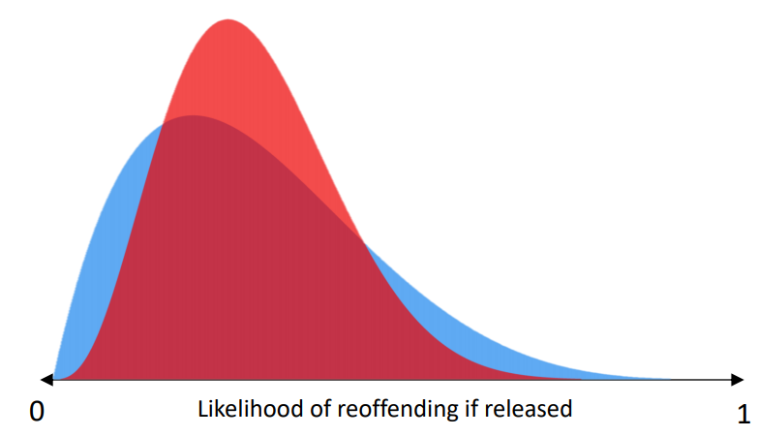
A single framework
Both tests belong in the same framework that uses hypothetical risk distributions and assumes the existence of a class-specific threshold.
This is a distribution of the probability of a specific outcome (crime being committed).
One risk distribution for each member of the sensitive variable.
Core Idea: The model assumes that decisions were made by comparing observed probabilities with a threshold (more on this later).
Note: Will reference the group’s previous work [Simoiu, ‘17], as well as the Supplementary Material for this paper on arXiv.

Slide 5
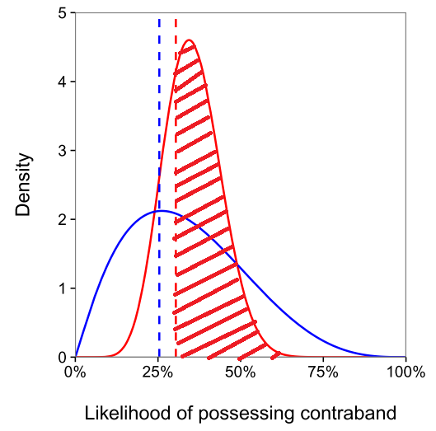
A single framework
The benchmark test → Compare decision rates.
Decision rate = Mass of p.d.f. larger than the threshold $t→ P(x>t)$

Slide 6
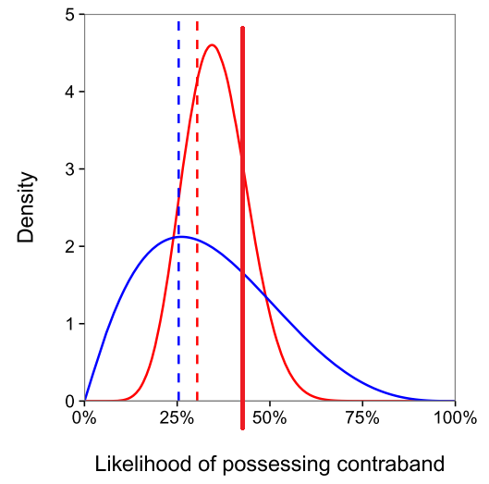
A single framework
The outcome test → Compare success rates.
Success rate = Expectation of p.d.f. conditionally larger than the threshold $t→E\left[x \right| x>t]$

Slide 7
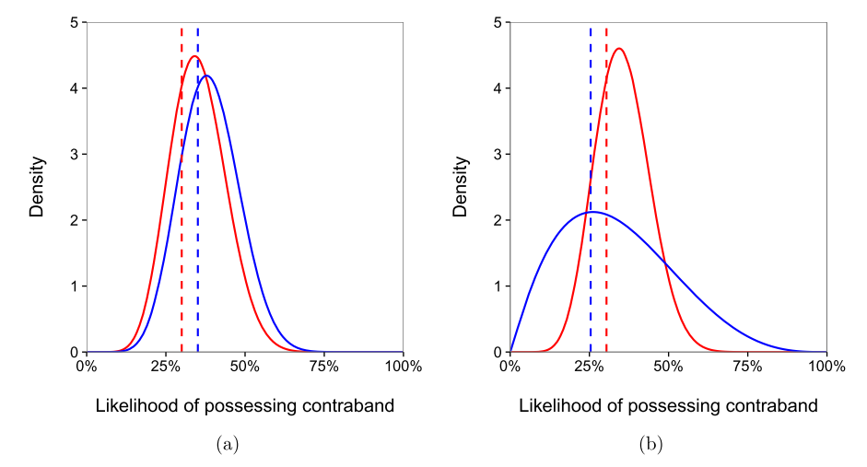
The problem of infra-marginality
Issue of the outcome test → Two different cases can exhibit similar hit rates.
Both models have the same decision/hit rates, but different (and swapped) thresholds!
Benchmark and outcome tests say that red is discriminated against in both cases.
This is false for the second case, where the blue search threshold is lower than red’s.

Slide 8
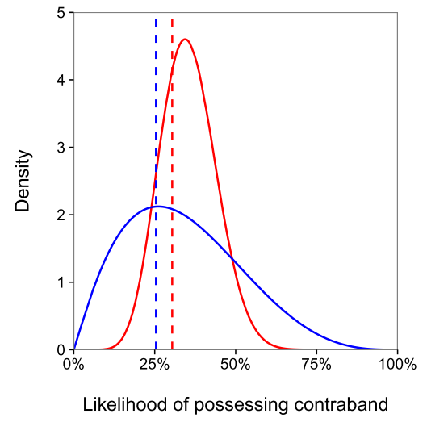
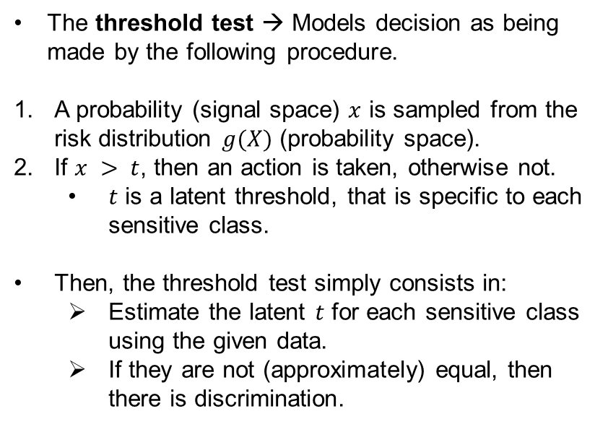
The threshold test
The threshold test → Models decision as being made by the following procedure.
A probability (signal space) $x$ is sampled from the risk distribution $g(X)$ (probability space).
If $x > t$, then an action is taken, otherwise not.
$t$ is a latent threshold, that is specific to each sensitive class.
Then, the threshold test simply consists in:
Estimate the latent $t$ for each sensitive class using the given data.
If they are not (approximately) equal, then there is discrimination.

Slide 9
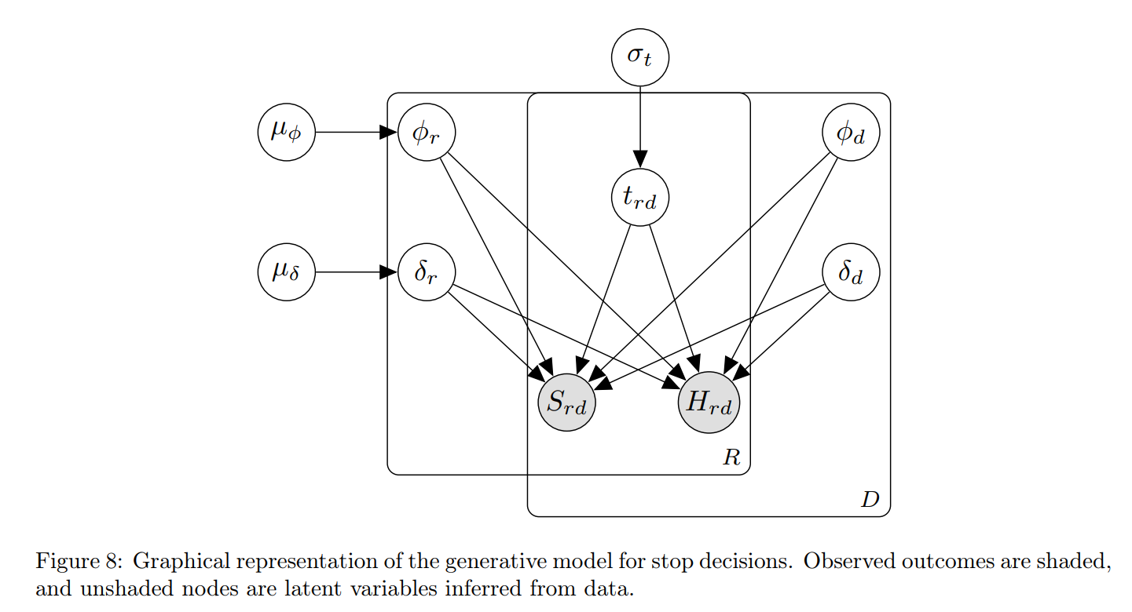
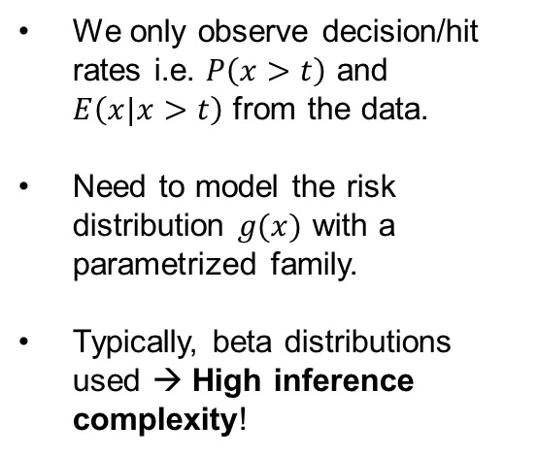
The threshold test
Estimating $t$ is easier said than done. Since this is a Bayesian model, need to estimate the entire model!
We only observe decision/hit rates i.e. $P\left(x>t\right)$ and $E\left(x|x>t\right)$ from the data.
Need to model the risk distribution $g(x)$ with a parametrized family.
Typically, beta distributions used → High inference complexity!

Slide 10
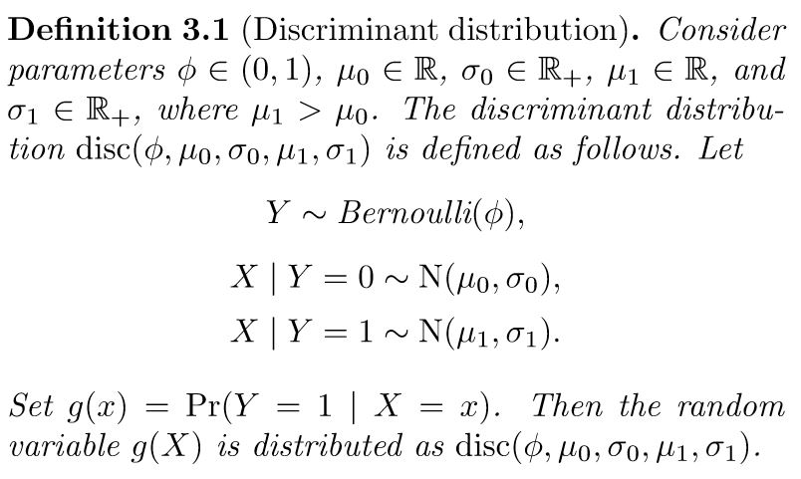
The discriminant distribution
Main contribution of this paper → Use a computation “friendly” model for $g(x)$.
Discriminant distribution → Very similar to model used in LDA.
Conditional distribution is assumed to be Gaussian.

Slide 11
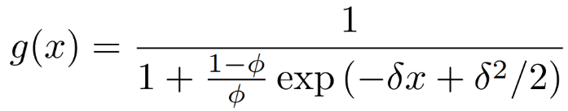
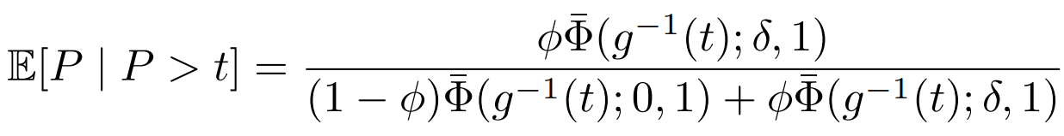
The discriminant distribution
Further, the authors show that two parameters are sufficient for disc instead of five.
Thus, $g\left(x\right) \sim disc(φ, δ)$ has a closed form expression:
This leads to compact, closed-form expression for the decision/success rates:

Slide 12
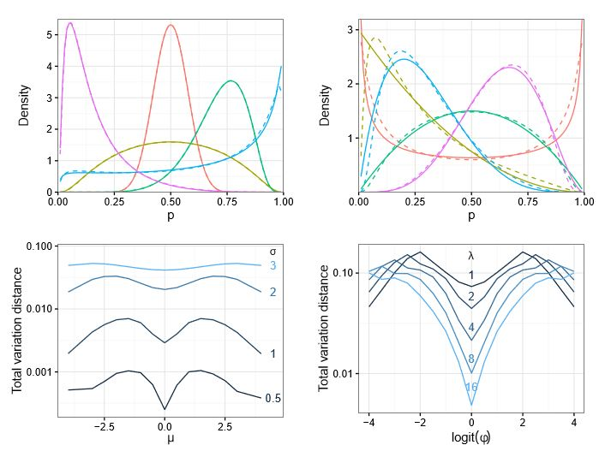
The discriminant distribution
Since this is an approximation, the authors investigate how well disc matches beta/logit-normal distributions.
Use TV distance as a distortion metric.

Slide 13
The discriminant distribution
Finally, using disc instead of beta distributions allows for:
Full Bayesian inference in reasonable (i.e. not weeks) times.
Very high accuracy.
OR
Hamiltonian Monte Carlo inference in very fast times.
Helped by the simple analytical expressions of disc.
Desired in very high dimensional inference networks, where complete Bayesian is non-practical.

Slide 14
Evaluation: Stop-and-frisk case study
Data: 2.7 million pedestrian stops conducted by NYC police (2008-2012)
Variables:
Race
Police precinct
Frisked or not
Weapon was found or not
Analyzed stops of whites, blacks and Hispanics
Used the threshold test to analyze two decisions:
Initial stop decision
Subsequent decision: Conduct a frisk
One threshold $t_{rd}$ for each combination
Correspond to decision/hit rates
Notes:
Frisked = patted-down in search of a weapon

Slide 15
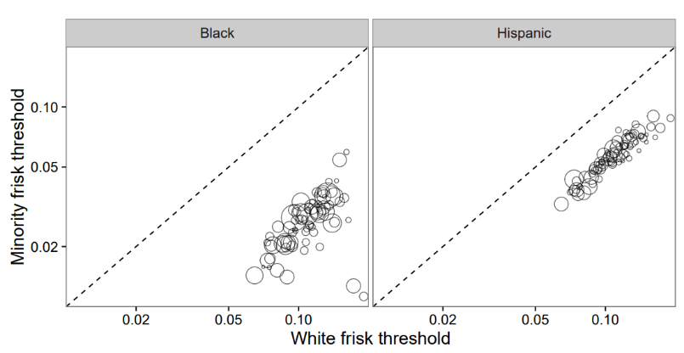
Bias in Frisk Decision
Complexity
Beta distributions: ~2 hrs
Discriminant distributions: <1 min
High correlation (0.95) between thresholds inferred using the accelerated model and original model
Discrimination against blacks and Hispanics
Inferred thresholds using the accelerated model
Notes:
Analyzing frisk decisions is a straightforward application of the threshold test
High correlation is expected and serves as robustness check.

Slide 16
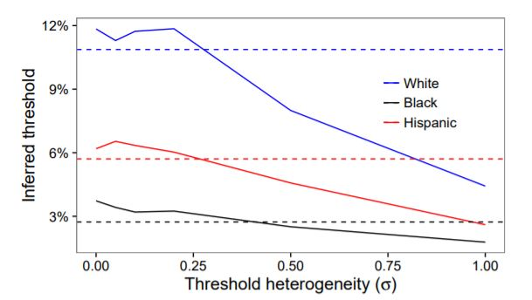
Bias in Frisk Decision
Robustness checks
Posterior predictive checks
Model-inferred frisk and hit rates for each precinct and race vs. observed rates
RMSE of frisk rates: 0.05%
RMSE of hit rates: 2.5%
Synthetic datasets
Generate dataset by sampling the presumed Bayesian model
Added noise to thresholds
dashed lines = unperturbed thresholds
Notes:
Posterior predictive checks: model fits the observed frisk rates and hit rates really well
Threshold noise: In realty, officers may apply different thresholds and the same officer might vary the threshold from one stop to the next.
Figure 2: Inferred frisk thresholds when the model is ﬁt to simulated data, where the threshold applied to each stop is perturbed by logit-normal noise. The dashed lines indicate the unperturbed thresholds. Racial disparities in thresholds persist even as large amounts of noise are introduced.

Slide 17
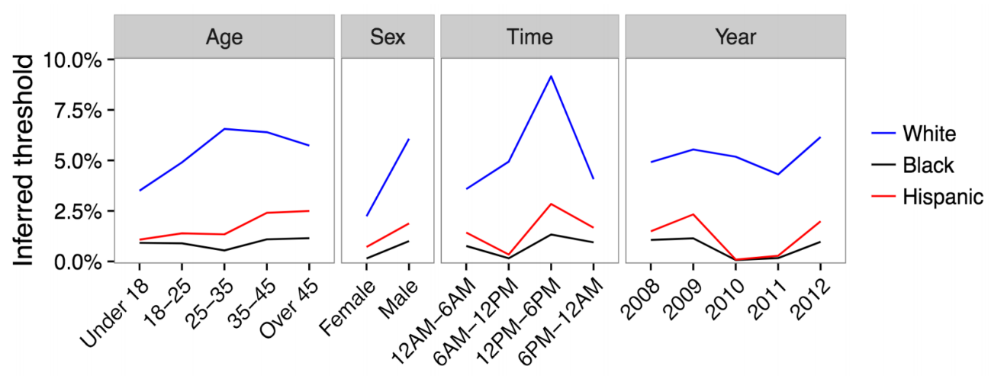
Bias in Frisk Decision
More robustness checks
Further split data / parametrize thresholds by year, time-of-day, age and gender.
Result: Thresholds for frisking blacks and Hispanics < whites → Discrimination
Notes:
Figure 3: Frisk thresholds inferred on disaggregated subsets of the primary dataset. While thresholds vary across subsets, thresholds for whites are consistently higher than thresholds for blacks and Hispanics.

Slide 18
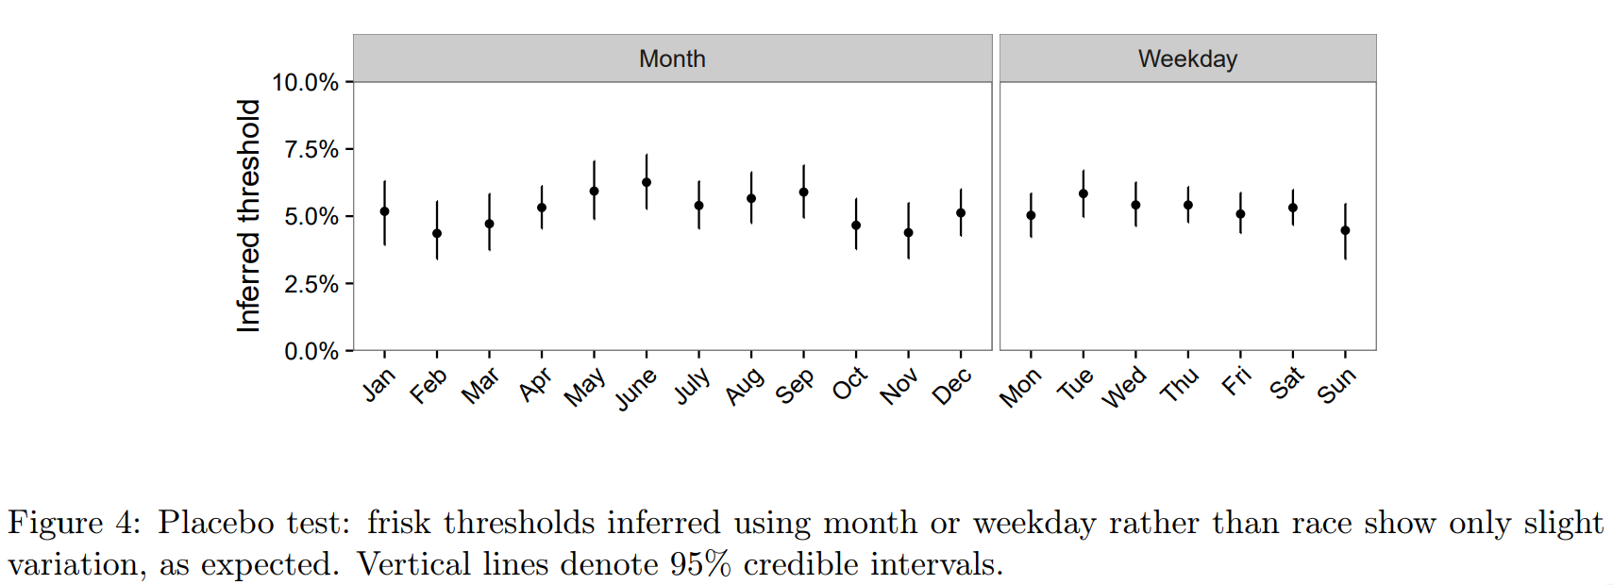
Bias in Frisk Decision
Even more robustness checks
Placebo tests:
Race replaced by day-of-week
Race replaced by month
Expected to yield roughly invariant threshold → True!

Slide 19
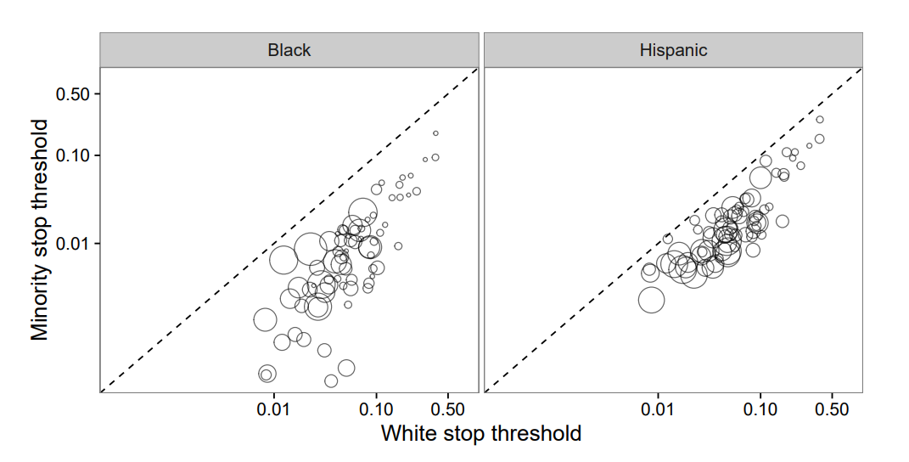
Bias in Stop Decision
Previous scenario used full Stop and Frisk rate information (data points).
This experiment effectively removes the data where the officer does not stop the person → censored data.
Some additional Bayesian modeling is introduced.
Inference time reduced from 4 hrs → 4 min.
Discrimination detected (again)

Slide 20
Conclusions
The threshold test overcomes ambiguities of the benchmark/outcomes tests for discrimination detection.
Relies on Bayesian modeling.
Using beta distributions for Bayesian inference is computationally complex.
The authors propose a discriminant distribution model with simple analytical expressions.
Speed-up of around 10-100x allows for running several interesting experiments that reveal discrimination.

Slide 21
Thank you!

